Slide 1
CX002-3-3
Introduction to Web Programming
Fundamentals of Web Programming
Prepared by: KAR First Prepared on: 21-01-2007 Last Modified on: xx-xx-xx
Quality checked by: xxx
Copyright 2007 Asia Pacific Institute of Information Technology

Slide 2
Learning Outcome
At the end of this lecture, the student will be able to:
  Define what is web programming.
  Identify the differences between web programs and standalone programs.
Slide <number> of 11

Slide 3
What are we going to learn today?
Survey on knowledge
Defining Web Programming
Slide <number> of 11

Slide 4
What is WWW?
A distributed document delivery service implemented using the client-server model running on the Internet
  Interoperability in a heterogeneous networked environment achieved by implementing shared protocols
Slide <number> of 11

Slide 5
What is WWW? (cont.)
A network of co-operating computers interoperating using HTTP and related protocols to form a sub-net of the Internet
  Like network news (Usenet) or UUCP.
A tool for collaborative writing and community building
  Blogs, wikis, podcasts
  Interactive games and chats
Slide <number> of 11

Slide 6
What is WWW? (cont.)
A framework that supports e-commerce
  On-line shopping and Business-to-Business
  Secure credit-card transactions
  Shopping carts
A large graph made up of WebPages and links
  WebPages are nodes; Links are edges
Slide <number> of 11

Slide 7
Defining Web Programming
What are Programs?
Why is Web Programming Different from other programs?
Web Programming Basics
  Web Pages (content delivery)
  Elements of Web Pages (content)
  URLs, HTTP, CGI (content requests)
Slide <number> of 11

Slide 8
What are ‘programs’?
A program is a sequence of written instructions which is compiled and executed by a computer. Typically it produces a runtime file such as .EXE or .CLASS
A script is a program which runs directly without pre-compilation
Web pages can be thought of as scripts which are interpreted by web browsers
Slide <number> of 11

Slide 9
Difference between Programs & Script
Program
Compiler
Binary Code
Result
(executed by CPU)
Script
Interpreter
Result
(executed by CPU)
HTML
Browser
Output
(executed by CPU)
Slide <number> of 11

Slide 10
Browser & Plug-ins
A plug-in is an adapter which lets browsers work with non-HTML
  e.g. Java VM: Java applets
  e.g. Flash: SWF Files
  e.g. Acrobat: PDF files
HTML
Applet
Browser
Output
PDF
Java
Acrobat
Slide <number> of 11

Slide 11
Web Programming
Programs usually get their data from the local disk
Web browsers get their ‘programs’ (HTML) from the local disk or remotely from a web site on the Internet
Web programming is inherently a client-server enterprise
Slide <number> of 11

Slide 12
Web Clients & Servers
The ‘client’ is usually the browser
The ‘server’ is usually a web server
Client-server communication relies on network protocols
HTTP Request
Web
Browser
Web
Server
Pages
Your Computer
Remote Computer
HTML Page
CLIENT
SERVER
Slide <number> of 11

Slide 13
Integrating All Together
Protocols:
CGI (Common Gateway Interface)
HTTP (Hypertext Transfer Protocol)
Content Authoring:
HTML (Hypertext Markup Language)
Web
Browser
Web
Server
Pages
CLIENT
SERVER
Client Scripts:
JavaScript
Client Programs:
Java Applets
Server Scripts:
Perl
Server Programs:
Java Servlet
Slide <number> of 11

Slide 14
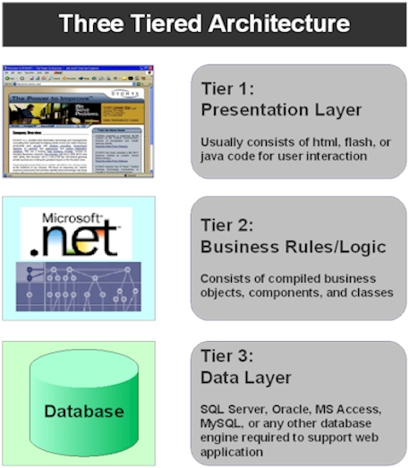
Three Tiered Architecture
Source: http://www.plantdata.com/services/software_development/dynamic_web_design.html
Slide <number> of 11

Slide 15
Q & A
Slide <number> of 16

